Slide 1

Bussines Analytics

Slide 2
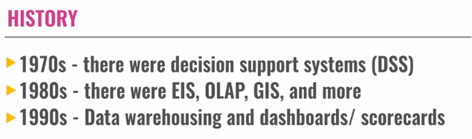
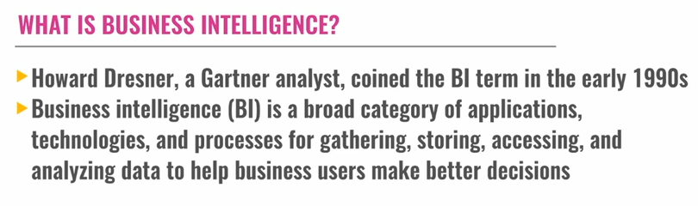
EVOLUTION OF ANALYTICS
Executive information systems
Online analytical processing

Slide 3
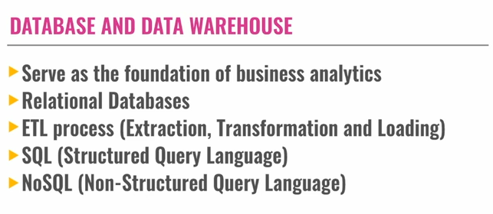
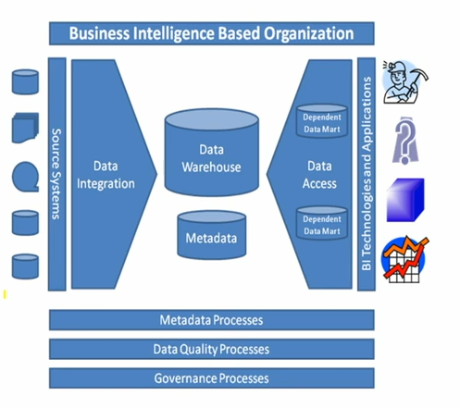
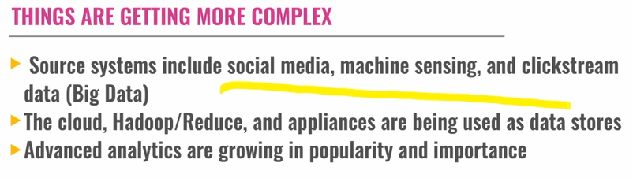
HADOOP

Slide 4
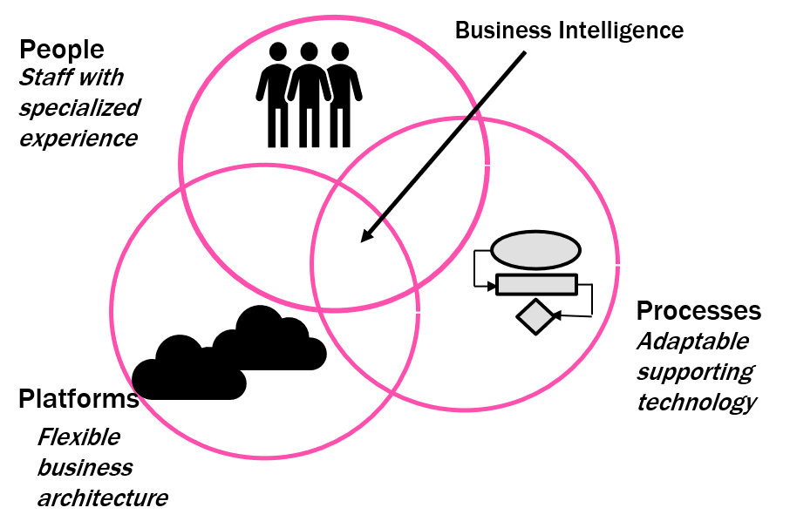
Define Database
A Database is an organized, machine-readable collection symbol, to be interpreted as a true account of some enterprise. A database is machine-updatable too, and so must also be a collection of variables. A database is typically available to a community of users, with possibly varying requirements.
Business Intelligence Defined
The Data Warehousing Institute, a provider of education and training in the data warehouse and BI industry defines Business Intelligence as:
“The processes, technologies, and tools needed to turn data into information, information into knowledge, and knowledge into plans that drive profitable business action. Business intelligence encompasses data warehousing, business analytic tools, and content\knowledge management.”

Slide 5
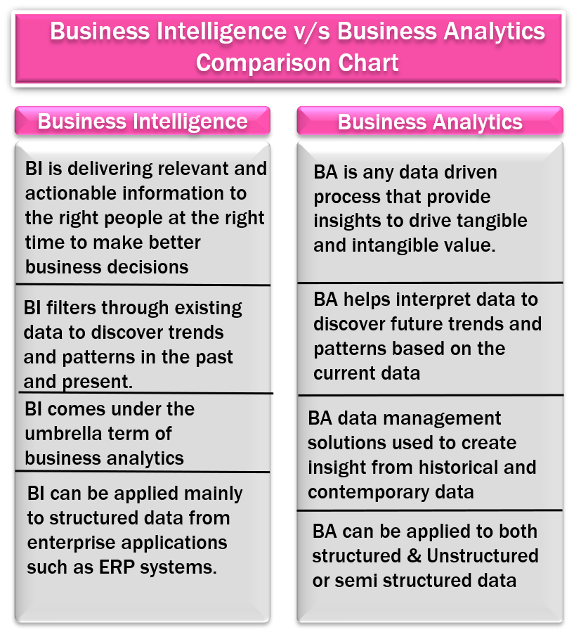
A BI program encompasses more than just a collection of software products and visualization tools. The value of BI comes from the processes for delivering actionable knowledge to the end-users, the processes for acting upon that knowledge, and the right people willing to take action. This means that without the processes and the right people, the tools are of little value.
The value of BI is the realization in the context of profitable business action. This means that if the knowledge that can be used for profitable action is ignored, the practice is of little value.

Slide 6
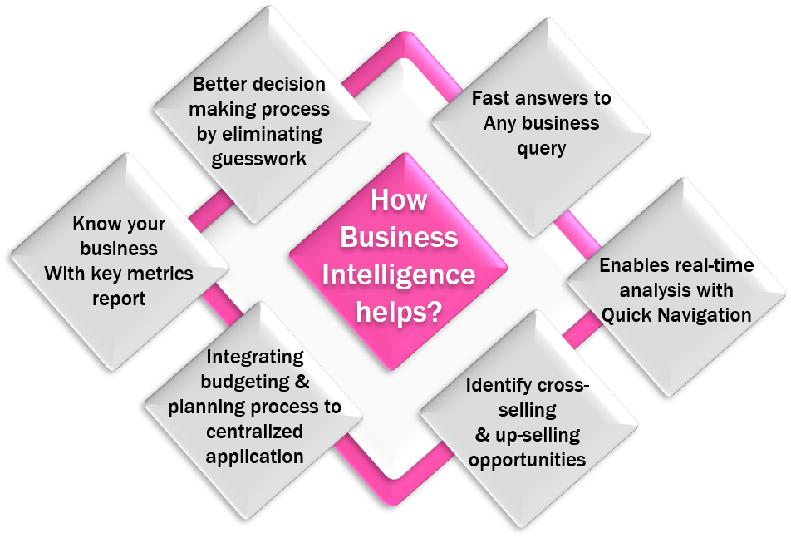
From the perspective of Information Systems (IS) Research, BI&A represents the latest evolution of technologies that have been developed to support managerial decision-making. This evolution began in the early 1960s, with the introduction of the first data processing systems. The idea of using the newly available data for supporting managerial decision-making led to the development of the first management information systems (MISs). In the following decades, these systems evolved through several stages, from personal decision support systems (PDSSs) to executive information systems (ELSs) and data warehouses (DWs) towards the current state-of-the-art technologies in BI&A. Each stage in this evolution increased data-processing capabilities, thus improving the available data basis or analytic capabilities and thereby providing more advanced capacities for data analysis.

Slide 7
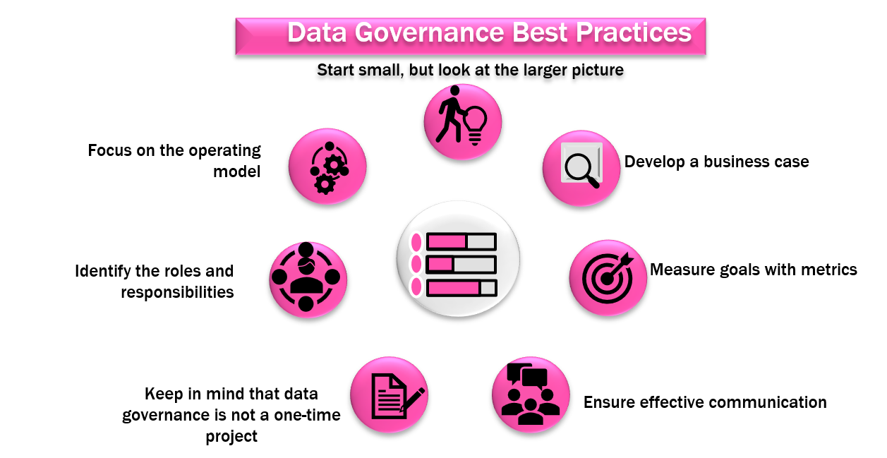
“Data Governance is the discipline of administering data and information assets across an organization through formal oversight of the people, processes, technologies, and lines of business that influence data and information outcomes to drive business performance.”

Slide 8
Data governance is largely about collaboration, for example, connecting data producers and data consumers, and managing common or shared data for the benefit of the enterprise. It is also about “decisions” determining who makes decisions about data. This is not to suggest that decisions are made centrally, but rather to determine what level and specifically who can best make different types of data decisions to expedite the decision process.
There are many types of metadata users due to the many types and sources of metadata. Users of Metadata can typically be divided into three categories:
Business Users: need to understand the business meaning of the data in the systems they use or own. Besides, they need to know the business rules and data access rules that apply to the data. Data stewards often perform the management of business metadata in terms of creation, maintenance, and usage on behalf of the business users and data owner.
Technology Users: Information technology (IT) professionals who are responsible for planning and building the transactional and analytic systems need to understand the end-to-end picture of the data to manage change. These users need the technical metadata for the technical information about the data environment, such as physical data structures, extract-transform-load (ETL) rules, reporting information, and impact analysis. Examples of technology users include data modelers, data integration architects, BI architects, designers, and developers.
Operational Users: Operational professionals are those who are responsible for the day-to-day operation of the data environment and are users of operational metadata. Operational metadata can assist them in identifying and resolving problems as well as managing change in the production environment by providing data information about the data integration processing and job processing impact analysis.

Slide 9
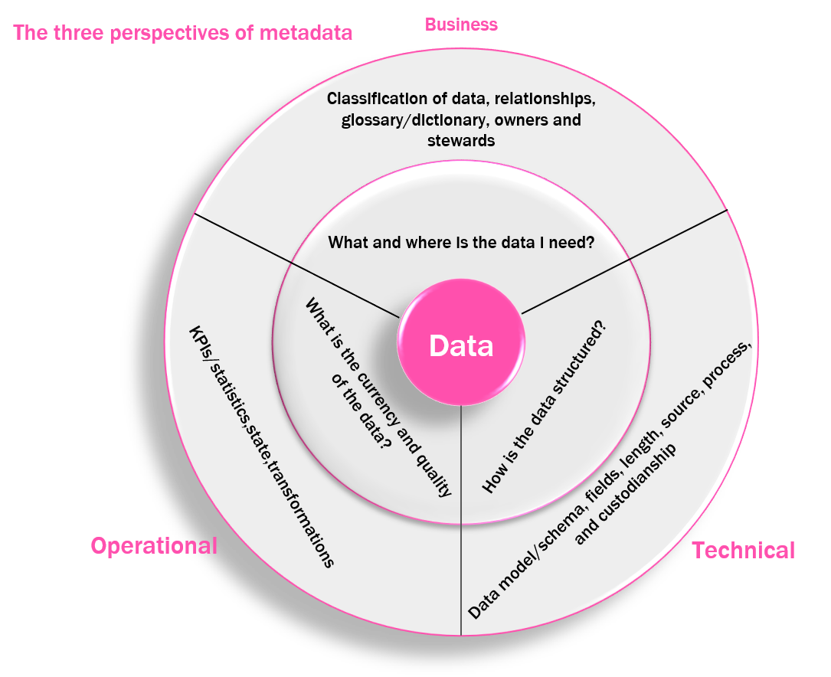

Slide 10
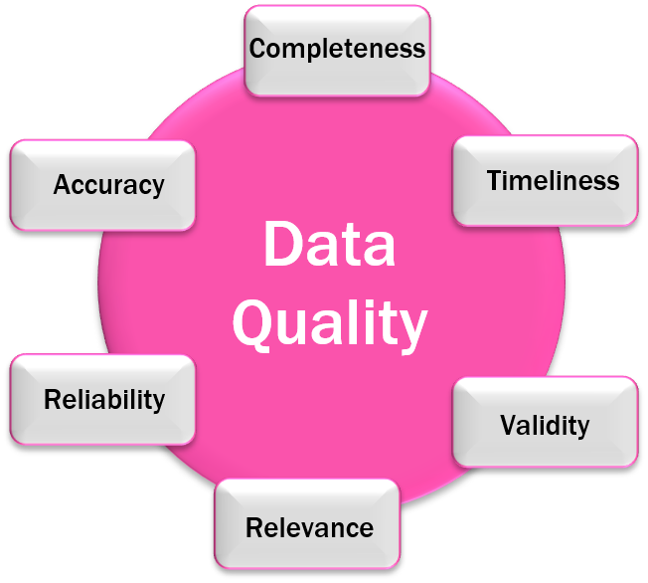
The formal definition of data quality is “the commonly understood business and technical definitions of data within defined ranges”. The confusing nature of data quality is that it is simply a part of the definition of the data; it is not a separate “component” of the data. Data quality is measured by how effectively the data supports the transactions and what it is used for. The level of data quality required to effectively support operations will vary by information system or business unit, depending on the information needed to conduct that business unit’s operations.

Slide 12
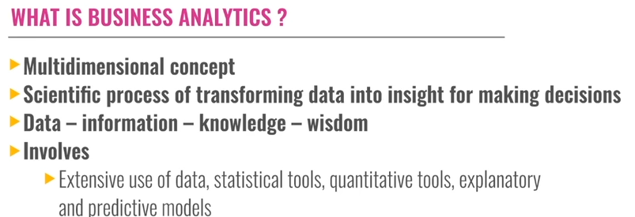
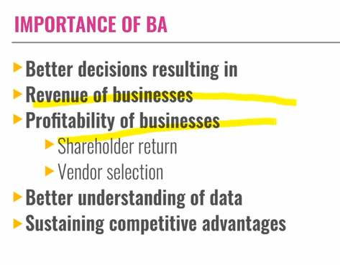
Introduction to Business Analytics

Slide 13
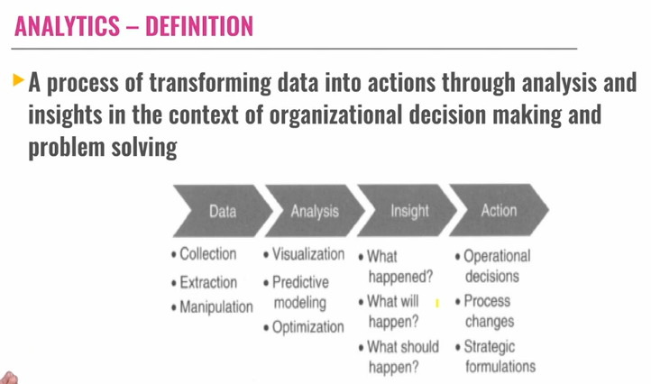

Slide 14
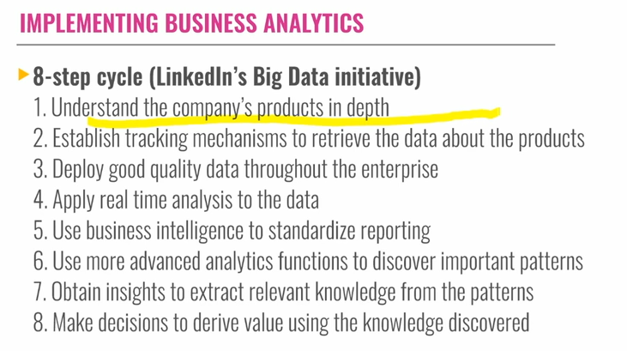

Slide 15
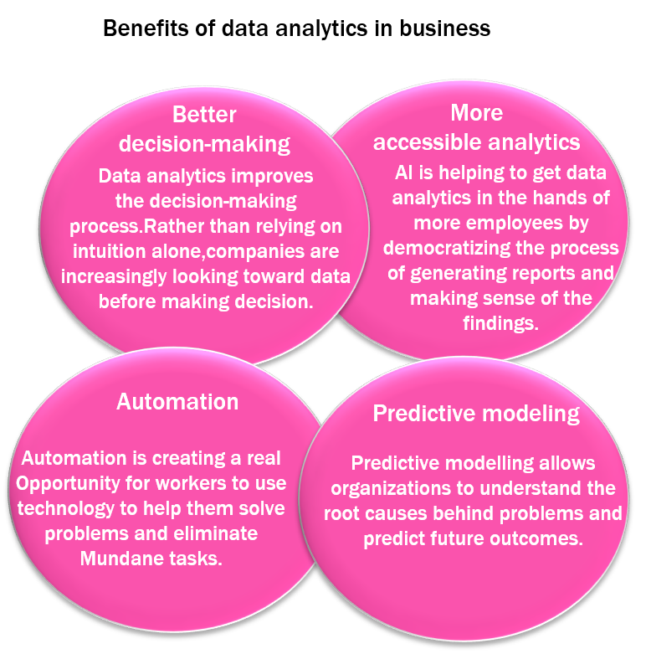
Business Analytics is the scientific process of transforming data into insight for making better decisions. Business analytics is used for data-driven or fact-based decision-making. Which is often seen as more objective than other alternatives for decision making.

Slide 16
Pero el análisis de negocios es lo más parecido a una bola de cristal para responder a preguntas importantes de negocios. Las respuestas se convierten en la base de información y conocimiento que hace que el análisis de negocios sea una herramienta valiosa para la toma de decisiones y ayuda a explicar por qué es importante aprenderlo y usarlo. La muestra de los tipos de preguntas que un análisis de negocios típico puede generar está relacionada no solo con cada paso en el proceso de análisis de negocios, sino también con el contexto del tiempo. Para comprender mejor el valor de la información que proporciona el análisis de negocios y entender por qué este tema es importante para mejorar el desempeño empresarial. Las empresas que hacen planes que generan resultados exitosos son ganadoras en el mercado. Las empresas que no planifican de manera efectiva tienden a ser perdedoras en el mercado. La planificación es una parte fundamental de la gestión de cualquier negocio. Si se hace bien, obtiene los resultados que desean los planificadores. La planificación de la organización empresarial generalmente se segmenta en tres tipos: descriptiva, predictiva y prescriptiva. El proceso de planificación generalmente sigue una secuencia desde la estrategia hasta la táctica y luego hasta la operativa.

Slide 17
Analytics – Definition
“Data Analytics is defined as a process of inspecting, cleansing, transforming, and modeling data to discover useful information, suggesting conclusions, and supporting decision making. Data analysis has multiple facets and approaches, encompassing diverse techniques under a variety of names, in different business, science, and social science domains.”
Tom Davenport’s book “Competing on Analytics” offers the following definition.
“By analytics, we mean the extensive use of data statistical and quantitative analysis, explanatory and predictive models, and fact-based management to drive decisions and actions. The analytics may be input for human decisions or may drive fully automated decisions.”
“Data Analytics is any activity that involves applying an analytical process to data to derive insight from the data.”

Slide 18
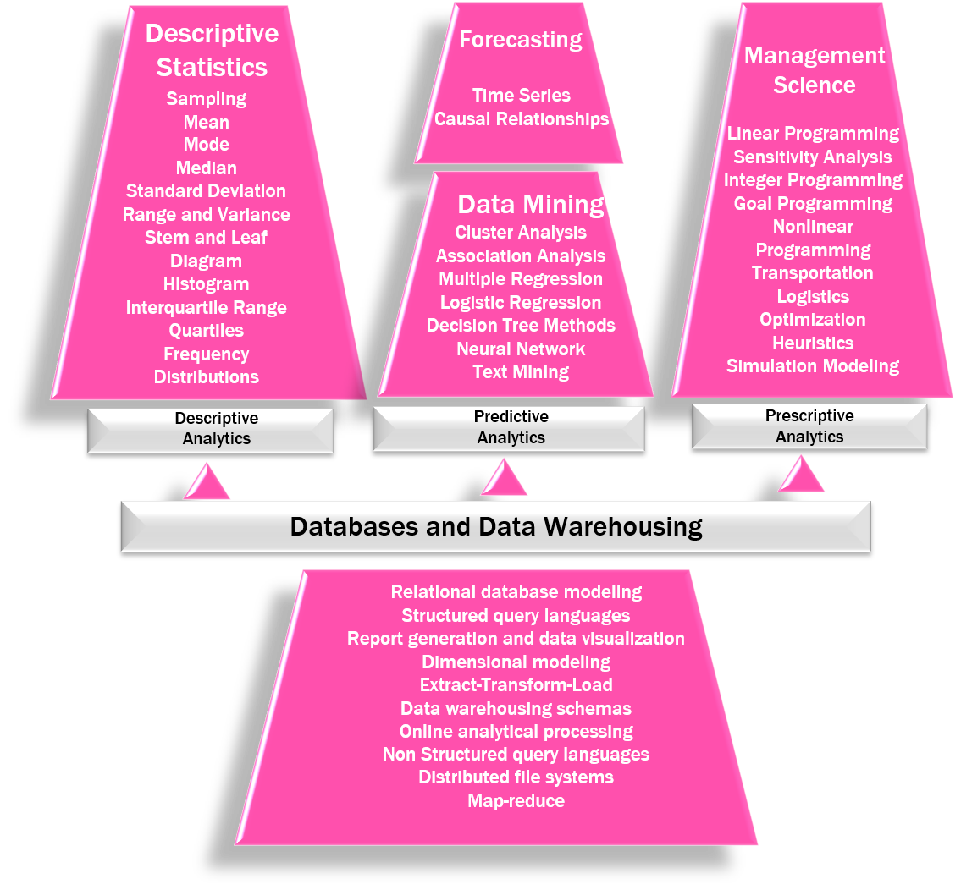

Slide 19
Implementing Business Analytics
As organizations are becoming more competitive by using business analysis, there is no doubt that practitioners, from both large and small companies, are eager to learn more about data analytics and how to implement it in their everyday decision-making. But how do managers implement business analytics in the workplace? Is there a methodology or a recommended set of steps that can be followed by practitioners? The examples of Target, LinkedIn, First Tennessee, and many other companies that have implemented data analytics can be used to derive practical steps for implementing analytics in organizational settings. Business Analytics initiatives in the Era of Big Data usually follow an Eight-Step Cycle:
Understand the company’s products in depth.
Establish tracking mechanisms to retrieve the data about the products.
Deploy good-quality data throughout the enterprise.
Apply real-time analysis to the data.
Use business intelligence to standardize reporting.
Use more advanced analytics functions to discover important patterns.
Obtain insights to extract relevant knowledge from the patterns.
Make decisions to derive value using the knowledge discovered.
These eight steps illustrate how organizations utilize all aspects of data analytics. LinkedIn, for example, uses information about its members, which is housed in operational databases. This information is then organized into a data warehouse and the analysts can use this information to explore the browsing history of LinkedIn members. Furthermore. LinkedIn uses descriptive statistics to generate reports and discover patterns. These patterns let the data analytical team at LinkedIn use predictive analytics to discover that speed is very important in receiving positive responses. Specifically, LinkedIn analysts were able to determine that “adaptation exponentially increases as the response time goes towards sub-seconds.” Finally, prescriptive analytics is used to generate appropriate actions. For example, LinkedIn could use optimization techniques to identify the best mix of companies or individuals, which maximizes the number of prospects or product sales.

Slide 20
Data analytics can help us to understand past trends and patterns, but it cannot predict the future with certainty. This is because there are always several factors that can affect the outcome of any event, and these factors are only sometimes known or predictable.
Metadata is data that describes other data. It can include information about the data's source, format, and meaning. Metadata is used by technology professionals to manage data, by operational professionals to understand data, and by business, units to make decisions based on data.
The few developments that contributed to the evolution of business analytics are personal decision support systems to executive information systems. The growth of business analytics has been driven by several developments, including the rise of personal computers, the development of data warehouses, the introduction of statistical and machine learning algorithms, and the increasing availability of data.
Data warehousing is the process of collecting and storing data from various sources within an organization in a centralized repository. The data is then organized and analyzed to help businesses make better decisions. Data warehouses were developed in the late 1990s, and they have evolved significantly over time. Today, data warehouses are used by businesses of all sizes to store and analyze vast amounts of data.
Business analytics is a process that involves the use of data to create predictive models using statistical and quantitative tools. Business analytics is a broad term that encompasses the use of data and analytics to improve decision-making. It can be used to collect data from a variety of sources, store it in a central repository, and then analyze it to identify trends, patterns, and insights.

Slide 21

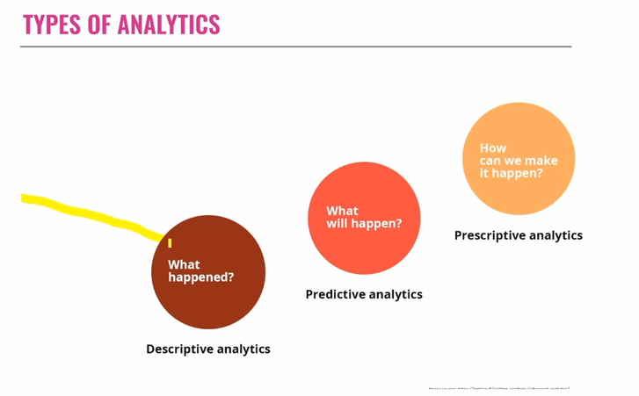

Slide 22
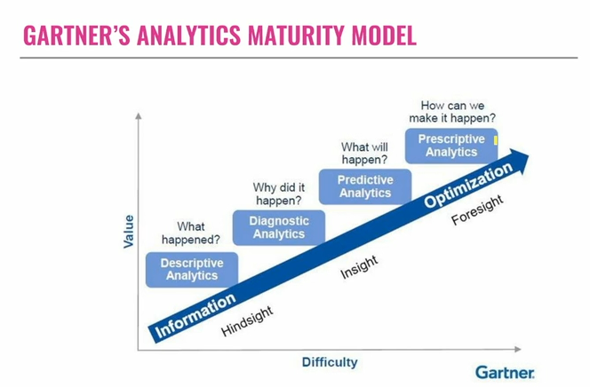

Slide 23
Gartner Maturity Model
Gartner's Maturity Model makes the point that enterprise information management (EIM) is not a single project per se. Rather, it is a long-term program that evolves. Gartner developed the maturity model to give insight and provide guidance to organizations that are serious about managing information as a strategic asset.
While this maturity model shows the steps in the maturity process and application of big data governance, it also presents action items for each level of maturity. Gartner’s EIM Concept presents an Integrated Approach to Managing Information Assets and has five major goals including:
Unified Content
Integrated Master Data Domains
Seamless Information Flows
Metadata Management and Semantic Reconciliation
Data Integration across the IT Portfolio

Slide 24
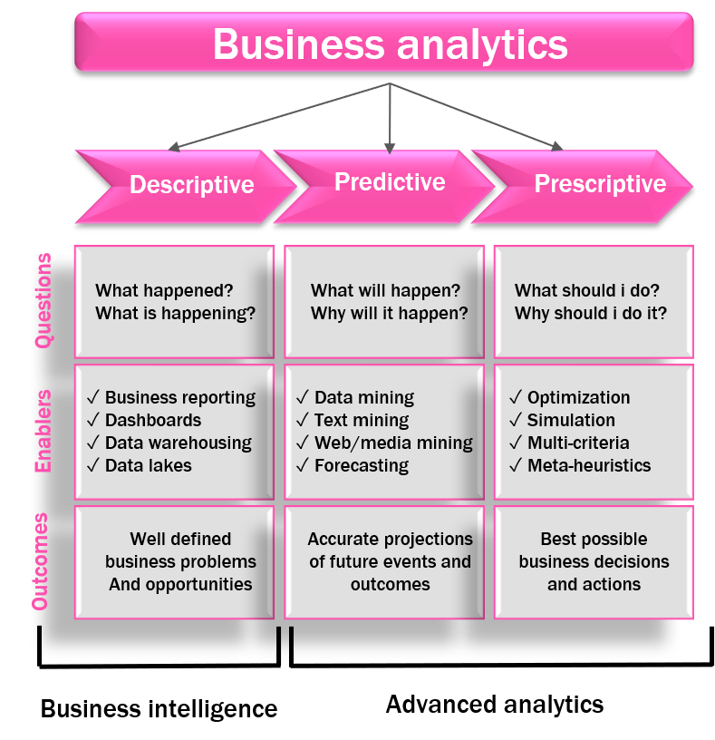
CATEGORIZATION OF ANALYTICAL METHODS AND MODELS
Business Analytics can involve anything from simple reports to the most advanced optimization techniques (methods for finding the best course of action). Analytics is generally thought to comprise three broad categories of techniques: Descriptive Analytics, Predictive Analytics, and Prescriptive analytics.

Slide 25
Descriptive Analytics | Predictive Analytics | Prescriptive Analytics
encompasses the set of techniques that describes what has happened in the past. Examples are data queries, reports, descriptive statistics, and data visualization including data dashboards, some data-mining techniques, and basic what-if spreadsheet models. | consists of techniques that use models constructed from past data to predict the future or ascertain the impact of one variable on another. For example, past data on product sales may be used to construct a mathematical model to predict future sales. This mode can factor in the product’s growth trajectory and seasonality based on past patterns. All of these are applications of predictive analytics. Simulation involves the use of probability and statistics to construct a computer model to study the impact of uncertainty on a decision. For example, banks often use simulation to model investment and default risk to stress-test financial models. Simulation is also often used in the pharmaceutical industry to assess the risk of introducing a new drug. | indicate the best course of action to take: that is, the output of a prescriptive model is the best decision. The airline industry’s use of revenue management is an example of prescriptive analytics. Airlines use past purchasing data as inputs into a model that recommends the best pricing strategy across all flights to maximize revenue. Another type of modeling in the Prescriptive Analytics category is simulation optimization, which combines the use of probability and statistics to model uncertainty with optimization techniques to find good decisions in highly complex and highly uncertain settings. Finally, the techniques of decision analysis can be used to develop an optimal strategy when a decision-maker is faced with several decision alternatives and an uncertain set of future events. Decision analysis also employs utility theory, which assigns values to outcomes based on the decision maker’s attitude towards risk, loss, and other factors.

Slide 26

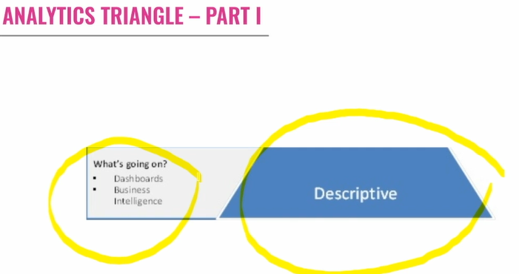
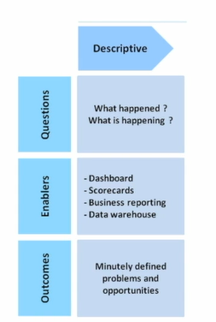
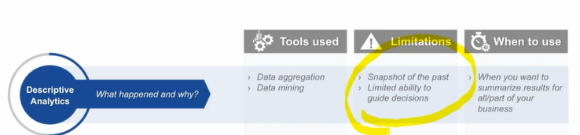

Slide 27
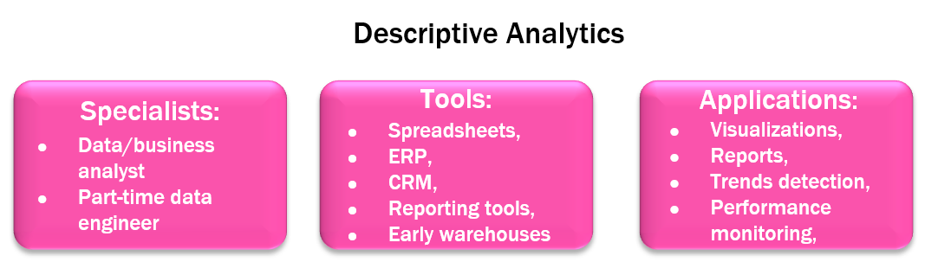
DESCRIPTIVE ANALYTICS
Descriptive Analytics is the most commonly used and most well-understood type of analytics. The goals are to categorize, characterize, consolidate, and classify data. Descriptive analytics techniques are most commonly applied to structured data, although numerous efforts have been made to extend their reach to unstructured data, often through the creation of structured metadata and indices. Descriptive analytics help provide an understanding of the past and also events occurring in real-time.
The Descriptive Analytics Tool must be a unified workplace for the entire organization that can be used to achieve these results:
Answer key business questions.
Explore all types of information from all angles to assess the current business situation.
Analyze facts and anticipate tactical and strategic implications by shifting from viewing to more advanced, predictive, or what-if analysis.
Collaborate to establish decision networks to share insights and drive toward a collective intelligence.
Provide transparency and accountability to drive alignment and consensus.
Communicate and coordinate tasks to engage the right people at the right time.
Access information and take action anywhere, taking advantage of mobile devices and real-time analytics.
Integrate and link analytics in everyday work to business workflow and process.

Slide 28
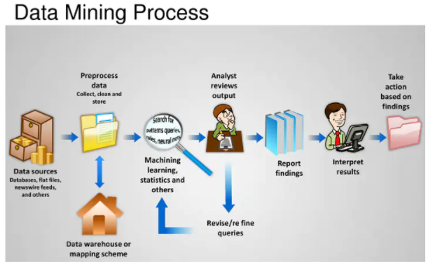
A Data Query is a request for information with certain characteristics from a database. For example, a query to a manufacturing plant’s database might be for all records of shipments to a particular distribution center during March. This query provides descriptive information about these shipments: the number of shipments, how much was included in each shipment, the data each shipment was sent, and so on.
Data Dashboards are collections of tables, charts, maps, and summary statistics that are updated as new data become available. Dashboards are used to help management monitor specific aspects of the company’s performance related to their decision-making responsibilities. For corporate-level managers, daily data dashboards might summarize sales by region, current inventory levels, and other company-wide metrics; front-line managers may view dashboards that contain metrics related to staffing levels, local inventory levels, and short-term sales forecasts.
Data Mining is the use of analytical techniques for better understanding patterns and relationships that exist in large data sets. For example, by analyzing text on social network platforms like Twitter, data-mining techniques are used by companies to better understand their customers. By categorizing certain words as positive or negative and keeping track of how often those words appear in tweets, a company like Apple can better understand how its customers are feeling about a product like the Apple Watch

Slide 29

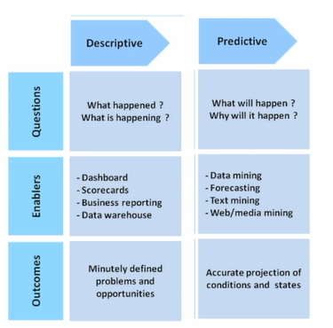
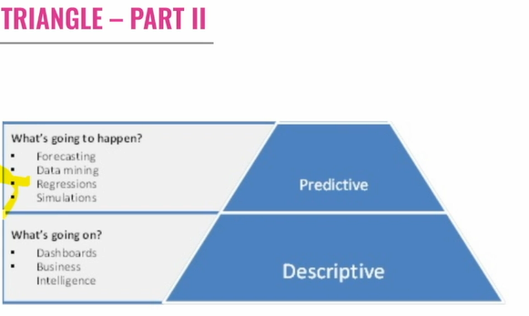

Slide 30
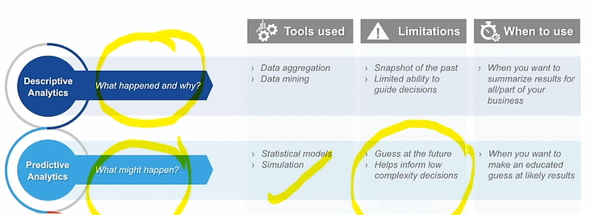
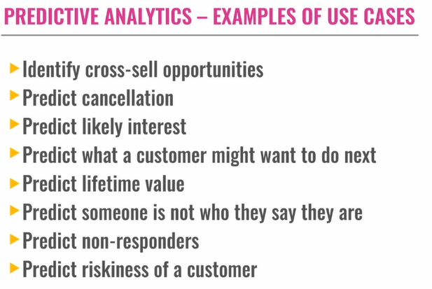

Slide 31
Whereas Descriptive Statistics are considered a straightforward presentation of facts, Predictive Analytics uses statistical modeling to draw conclusions and predict future behavior based on the assumption that what has happened in the past will continue to happen in the future. Some of the common tools used in descriptive statistics include cluster analysis, association analysis, multiple regression, logistic regression, decision tree methods, neural networks, and text mining. Forecasting tools, such as time series and causal relationships, are also classified as Predictive Analytics.
The Role of Predictive Model
Predictive Models help to identify which customers are most likely to purchase a product or service. There are three main steps in this example, which are described in turn below.
Step 1: Suppose that the company has carried out a marketing trial on a sample of its customers. For this group of people, the company knows whether each customer was a purchaser (P) or a non-purchaser (N). In addition, a number of attributes are known for every customer, their length of the relationship, previous transaction history, the usual method of payment, and so on. These are the available predictor variables.
Step 2: These pieces of information are examined by your analyst to produce a scorecard or scoring formula; the scorecard weights and combines the most useful variables to calculate a model score for each customer, such that purchasers are assigned high scores and non-purchasers receive low scores.
Step 3: The list of customers is sorted from highest down to lowest model scores, and is typically divided into 10 score bands based on this ranking. Your analyst then looks at band 1 (highest scores) and finds that it contains a high number of purchasers. Not everyone has purchased, but the purchase rate is perhaps three or four times the overall average. In-band 2, the purchase rate is also well above average, but not quite as high as for band 1. Similarly, the purchase rate continues to decrease in subsequent bands - by band 10, the rate is very low; however, band 10 still contains a small number 0f people who made a purchase for some unknown reason.

Slide 32

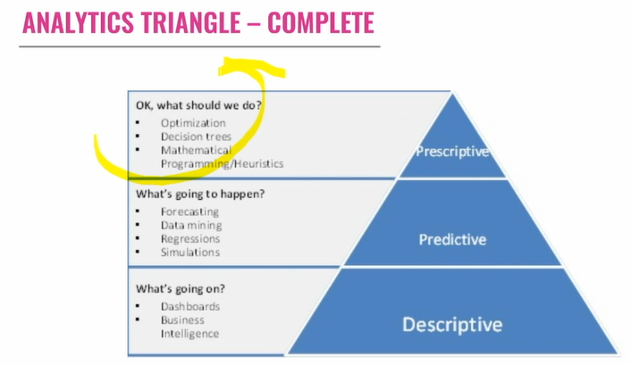

Slide 33
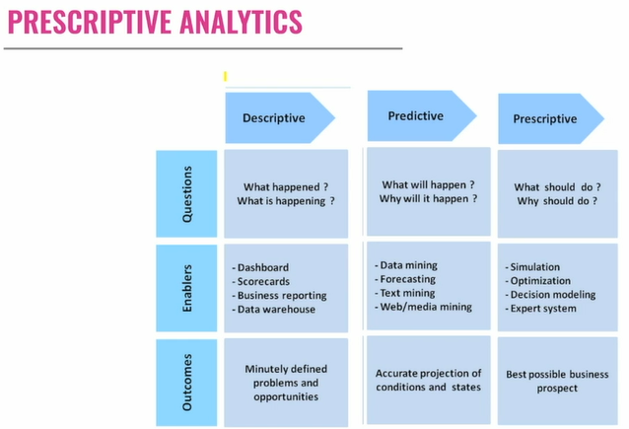

Slide 34
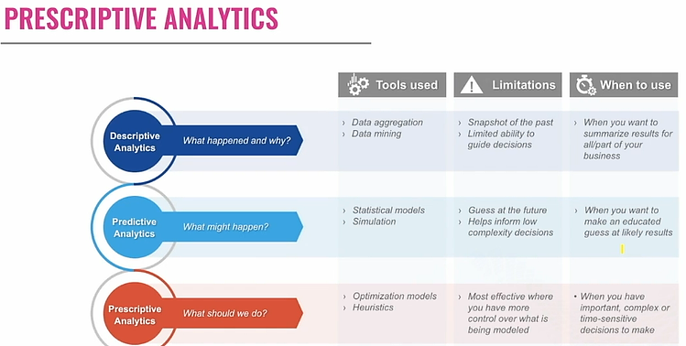

Slide 35
PRESCRIPTIVE ANALYTICS
Some of the most common models used in Prescriptive Statistics include linear programing, sensitivity analysis, integer programing, goals programing, nonlinear programing, and simulation modeling.
Practitioners use Prescriptive Analytics to make decisions based on data. For example, the Prescriptive tools allow for ticket price offerings to change every hour. Fandango has learned when the most desirable movie times are by sifting through millions and millions of show times instantaneously. This information is then used to set an optimal price at any given time, based on the supply of show times and the demand for movie tickets, thus maximizing profits.
Prescriptive Analytics can help the movie industry to ensure that their pricing structures are optimally set to contribute to bottom-line results. Similarly, Prescriptive Analytics can help airline industries maximize their revenues by making sure that the highest prices are charged during the highest times of demand as well as by lowering the prices when the demand is low. The combination of Big Data with Prescriptive tools allows the airlines to adopt pricing policies that go beyond traditional peak, off-peak, or shoulder seasons. Changes are dynamic and in real-time: they can be implemented within the days of the week or even the hours of the day. Prescriptive Analytics is the engine of today’s real-time business intelligence.

Slide 36
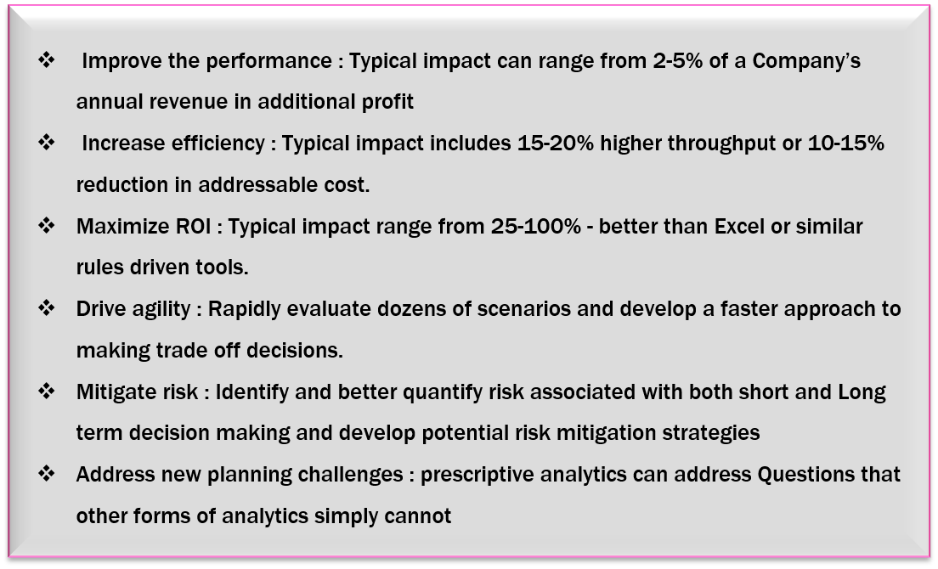
Benefits of Prescriptive Analytics to your Business

Slide 37
Prescriptive analytics is a type of analytics that uses data to recommend specific actions that can be taken to improve future outcomes. It answers the question of "What should we do?" For example, a business might use prescriptive analytics to design a pricing strategy for air tickets based on previous purchasing data. The analytics would identify the prices that are most likely to maximize revenue, while also ensuring that the business is not pricing itself out of the market.
Both regression analysis and simulation are the main tools that are used for predictive data analysis. Regression analysis is a statistical method that is used to predict the value of a dependent variable based on the values of one or more independent variables. Simulation is a technique that is used to create a model of a real-world system and then run experiments on the model to see how the system would behave under different conditions.
Prescriptive analytics drives real-time business operations in the present day. It not only analyzes historical data and predicts future outcomes but also provides actionable recommendations, enabling businesses to make informed decisions on the spot, gain a competitive edge, and optimize their operations for maximum efficiency.
The different sources of information that can be used for descriptive analytics include dashboards, scorecards, business reports, transactional data, operational data, social media data, and sensor data. These data sources can be used to provide valuable insights into an organization's performance.
Linear programming is a mathematical optimization technique that can be used to find the best solution to a problem with a set of constraints. This can be useful in prescriptive analytics, as it can help to find the best course of action to take given a set of business objectives.

Slide 39

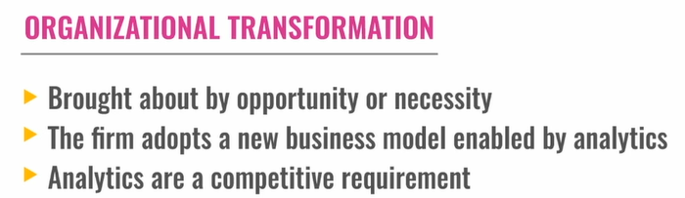
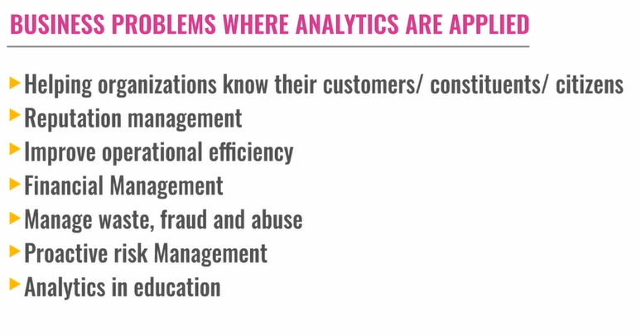

Slide 40
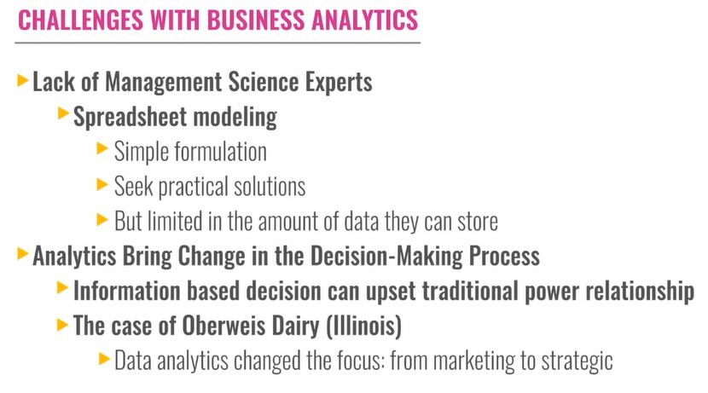

Slide 41
ANALYTICS IN ORGANIZATION
Organizational Transformation
Organizational Transformation is a particular type of change that can be distinguished from incremental, translational, and other forms of organizational change. Drawing out the distinguishing features of transformational change will help to establish the domain for the integrative metatheory.
Organizational Change and Transformation
Organizational Change is an important concept that lies at the heart of much organization theory. Change theorists Andrew Van de Ven and Marshall Poole regard organizational change as “An empirical observation of differences in form, quality, or state overtime in an organizational entity”.
This Empirical Approach to defining change has three essential aspects:
Change is observable
Change is not merely an array of differences but an alteration in the same entity over time, and
Change affects all aspects of the organization.
While change itself may be observable, understanding and explaining change is also a matter of making inferences and of presuming relationships between organizational characteristics that may not be directly observable. To this point Van de Ven and Poole say (1988):
“While organizational change can be directly observed empirically, it is important to emphasize that the process of change is a latent inference, that is, it is a theoretical explanation for the pattern of changes observed.”

Slide 42
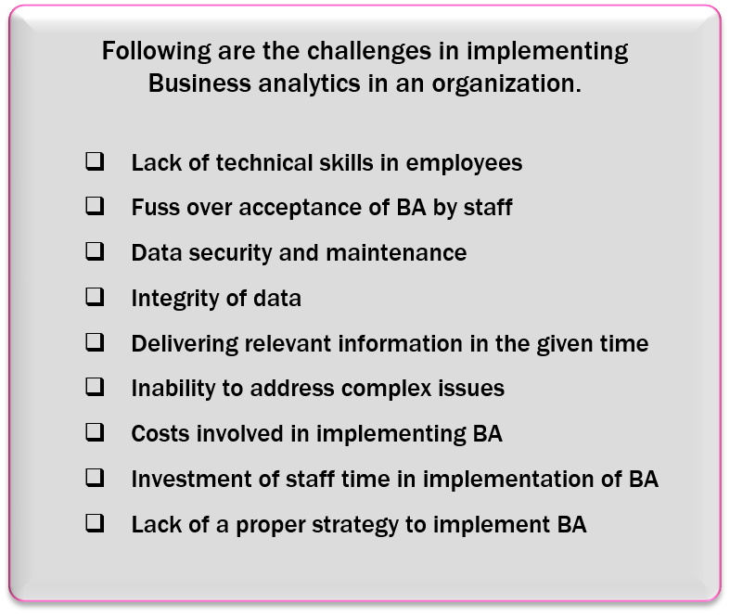
Challenges with Business Analytics
Just as business analytics offers significant microeconomic advantages it carries with it various challenges that, when left unmanaged, eliminate major sources of competitive advantage. In the immortal words of Heinlein and Friedman, “there is no such thing as a free lunch.” Business Analytics is a complex discipline and success requires focus. There are many moving parts and when left unattended, chaos and uncertainty tend to be the major outcome.

Slide 43
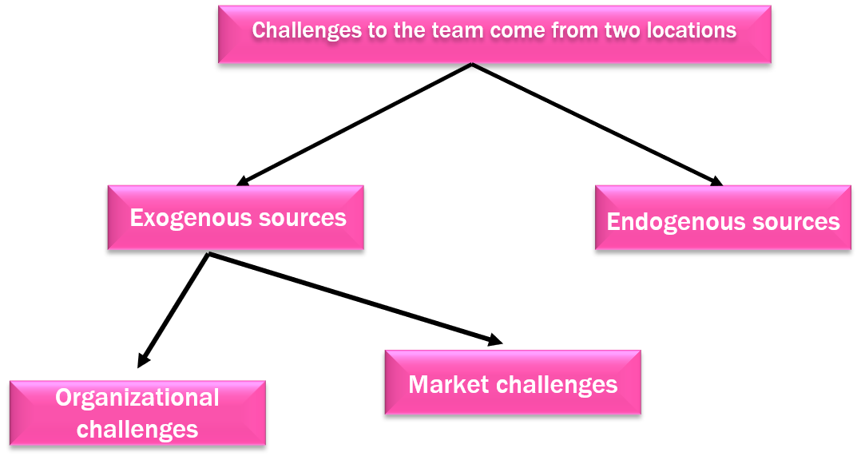
Todo equipo de Análisis de Negocio opera dentro de una gran organización, independientemente de si forma parte de un gran grupo funcional o de un centro de excelencia por derecho propio. El equipo se enfrenta a una amplia variedad de complejidades que plantean desafíos diarios. A su vez, la organización se enfrenta a diversos desafíos competitivos y regulatorios, muchos de los cuales deben superarse para alcanzar el éxito.
Para complicar aún más las cosas, el equipo de Análisis de Negocio a menudo no asume la responsabilidad del proceso de ejecución. Si bien los recursos que crea pueden ser un insumo crucial para la eficiencia de estos procesos, a menudo escapa a su control actuar en función de la información que genera.
Exogenous sources, such as the environment within which the team operates.
Endogenous sources, such as the skills and capabilities of the team.

Slide 44
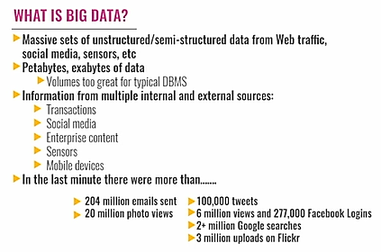

Slide 45
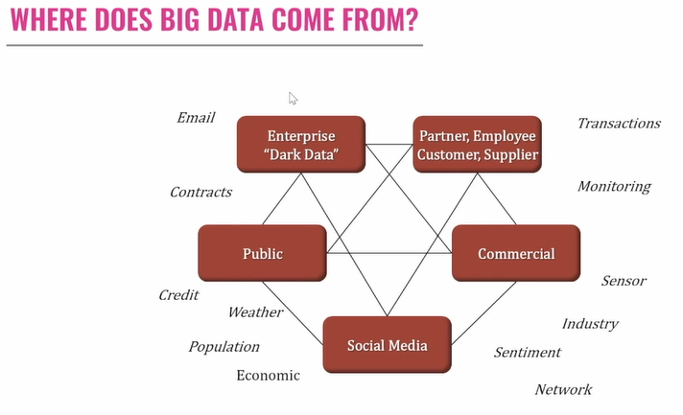

Slide 46
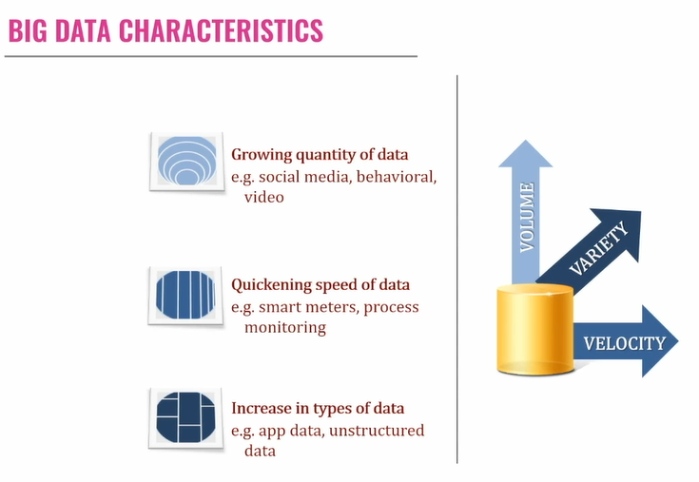
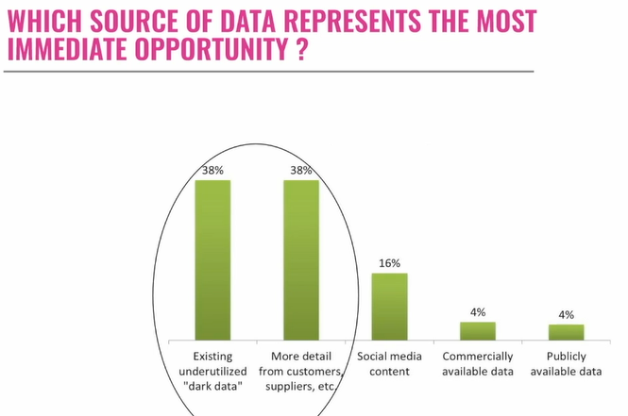

Slide 47
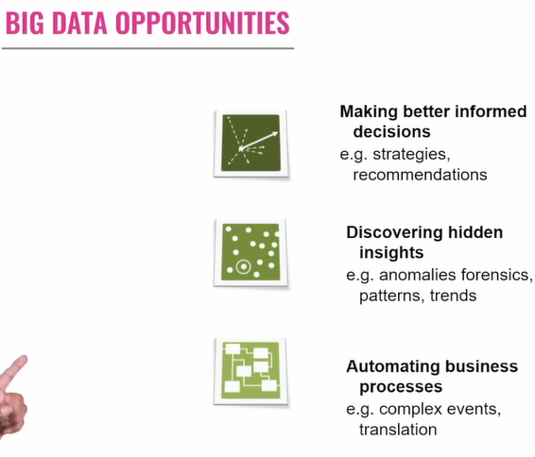

Slide 48
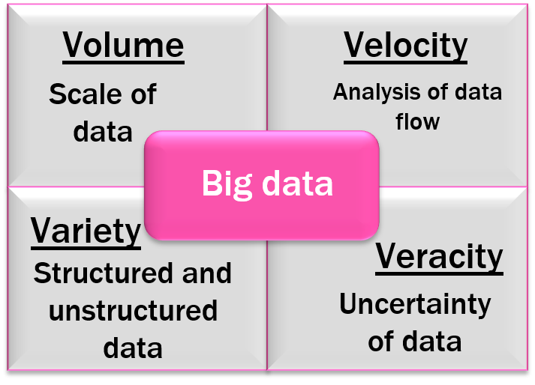
WHAT IS BIG DATA ?
Big Data is a process to deliver decision-making insights. The process uses people and technology to quickly analyze large amounts of data of different types (traditional table structured data and unstructured data, such as pictures, video, email, transaction data, and social media interactions) from a variety of sources to produce a stream of actionable knowledge.
We include several frequently referenced definitions next for context and comparison. According to the McKinsey Global Institute:
“Big Data” refers to datasets whose size is beyond the ability of typical database software tools to capture, store, manage, and analyze. This definition is intentionally subjective and incorporates a moving definition of how big a dataset needs to be considered Big Data – I.e., we don’t define big data in terms of being larger than a certain number of terabytes (thousands of gigabytes). We assume that, as technology advances over time, the size of datasets that qualify as big data will also increase. Also note that the definition varies by sector, depending on what kinds of software tools are commonly available and what sizes of datasets are common in a particular industry.

Slide 49
Gartner Indicates the Following:
Big data is high-volume, high-velocity, and high-variety information assets that demand cost-effective, innovative forms of information processing for enhanced insight and decision making.
Four Primary Technologies for Accelerating Processing of Huge Data Sets
Grid Computing: A centrally managed grid infrastructure provides dynamic workload balancing, high availability, and parallel processing for data management, analytics, and reporting. Multiple applications and users can share a grid environment for efficient use of hardware capacity and faster performance, while IT can incrementally add resources as needed.
In-Database Processing: Moving relevant data management, analytics and reporting tasks to where the data resides improves speed to insight, reduces data movement, and promotes better data governance. Using the scalable architecture offered by third-party Databases, in-Database processing reduces the time needed to prepare the data and build, deploy and update analytical models.
In-Memory Analytics: Quickly solves complex problems using big data and sophisticated analytics in an unfettered manner. Use concurrent, in-memory, multi-use access to data and rapidly run new scenarios or complex analytical computations. Instantly explore and visualize data. Quickly create and deploy analytical models. Solve dedicated, industry-specific business challenges by processing detailed data in memory within a distributed environment, rather than on a disk.
Visual Analytics: Using Visual Analytics, one can very quickly see correlations and patterns in big data, identify opportunities for further analysis and easily publish reports and information to an iPad. Because it’s not just the fact that you have big data, it’s what you can do with the data to improve decision-making that will result in organizational gains.

Slide 50
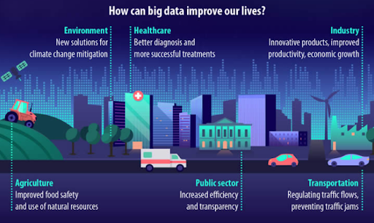

Slide 51
Spreadsheet modeling is a valuable tool for business analytics. It is a versatile tool that can be used for a variety of tasks. By using spreadsheets, organizations can gain insights into their data and make better decisions that can help them improve their performance and achieve their goals.
Dark data refers to data that remains unused or untapped within an organization. This data typically exists in various forms, such as archived documents or unanalyzed information, and holds the potential for valuable insights if properly explored and leveraged.
Analytics can be applied to a wide range of areas in an organization, including; financial management, abuse management for social media platforms, and efficient operational performance. Analytics can also be used in other areas, such as marketing, customer service, and risk management. By using analytics, organizations can gain insights into their data and make better decisions that can help them improve their performance and achieve their goals.
Automation of a business process is one of the opportunities of big data. Big data is a term used to describe the large and complex datasets that are generated by organizations daily. These datasets can include information about customer transactions, social media posts, sensor data, and more.
Analytics requires a range of skills and expertise, including data science, statistics, and machine learning. Organizations may not have the necessary expertise in-house and may need to hire external consultants.

